Slide 1
Cross Platform HTML5 app
Let’s Get Started…

Slide 2

What we need
Any Cordova Tool
or Intel XDK
“Intel App Preview” app

Slide 3



App Overview

Slide 4
Features
HTML5 works on all modern mobile devices!
We use…
jQuery for speed and navigation
Bootstrap for responsive web design

Slide 5
Testing our app

Slide 6
Testing our app
Download and install Intel XDK
https://software.intel.com/en-us/html5/tools

Slide 7
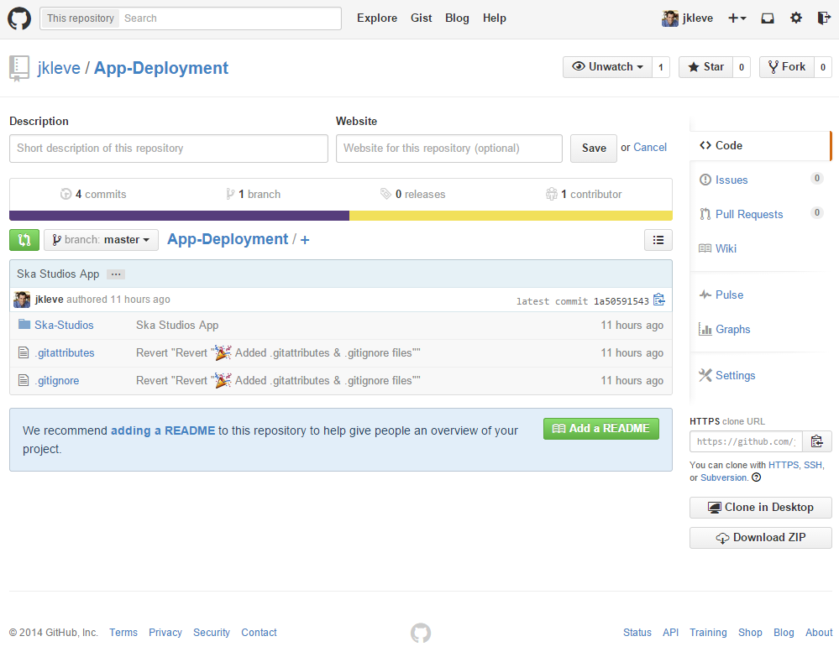
Testing our app
Download at:
https://github.com/jkleve/App-Deployment

Slide 8
Testing our app
Unzip the folder, and put it on the desktop
Launch Intel XDK
Login or create a new Intel account

Slide 9
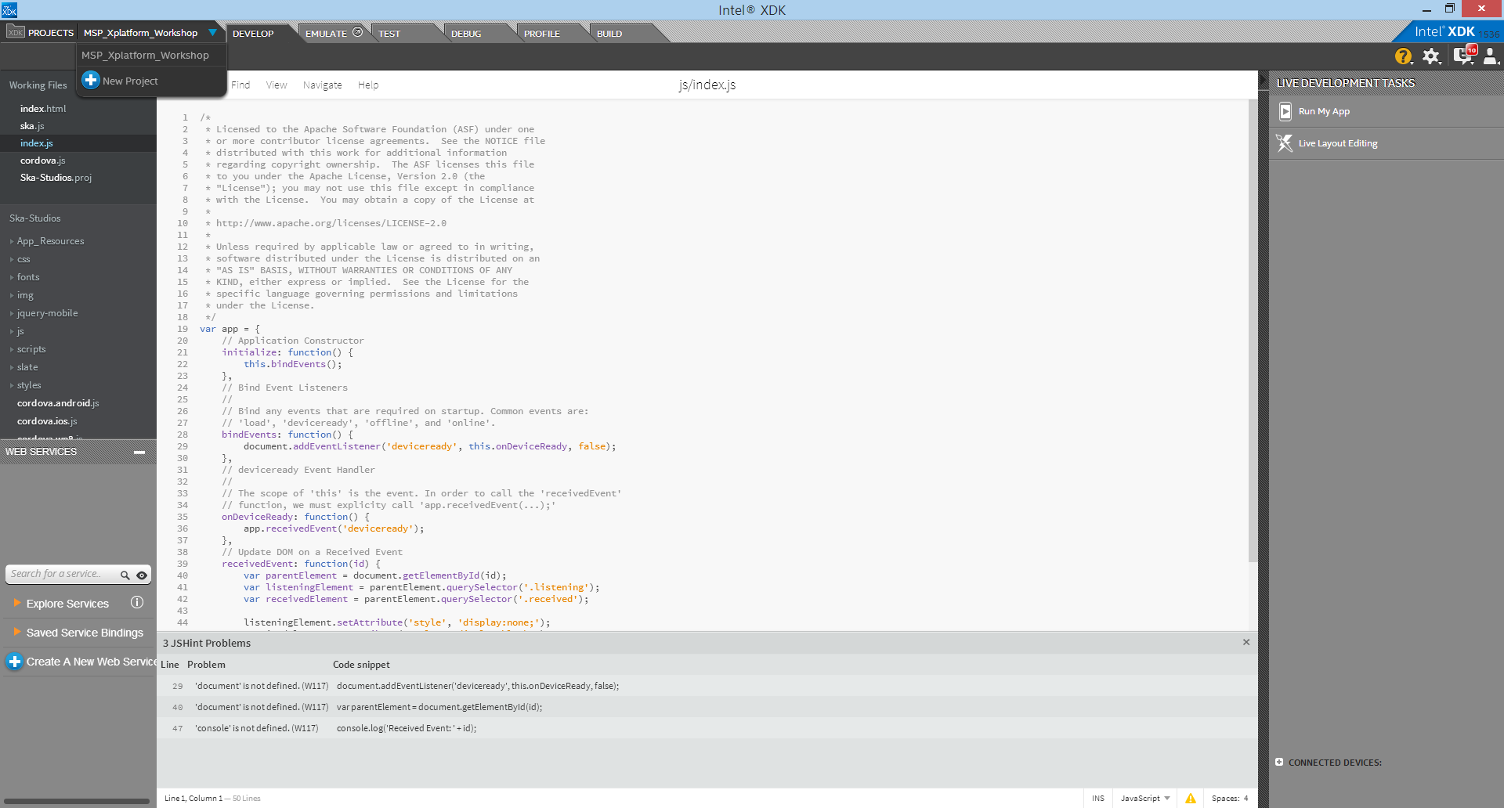
Testing our app
Create a new project

Slide 10
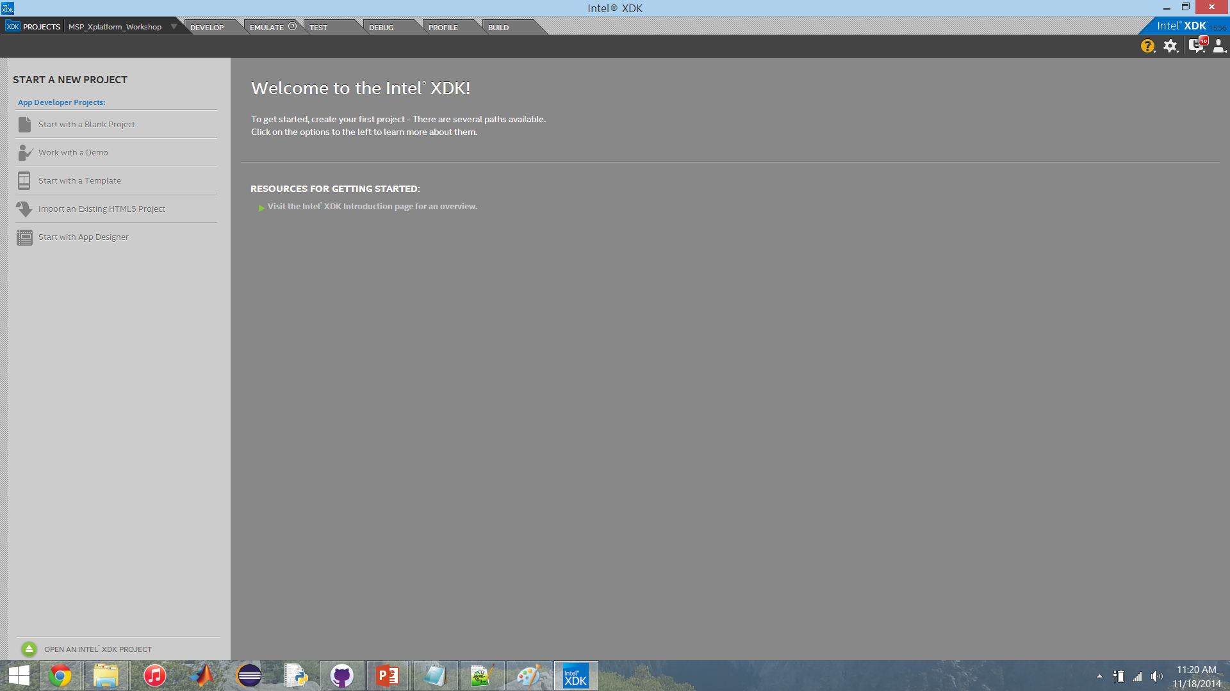
Testing our app
Import an Existing HTML5 Project

Slide 11
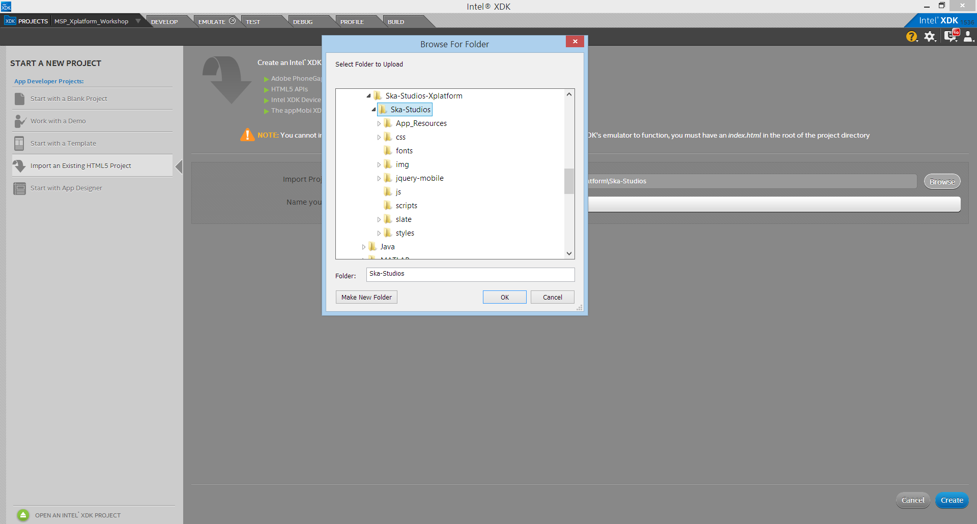
Testing our app
Browse for this folder
Name the project

Slide 12
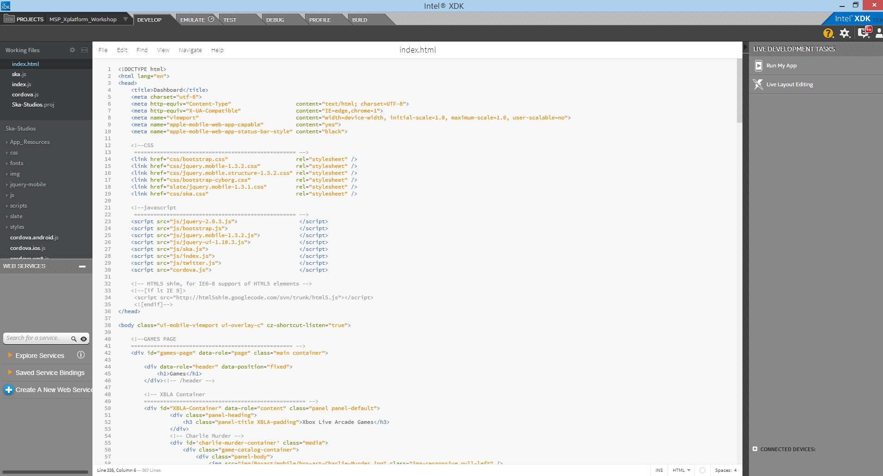
Testing our app
You now have a working app to build from.
Index.html is a good place to start

Slide 13
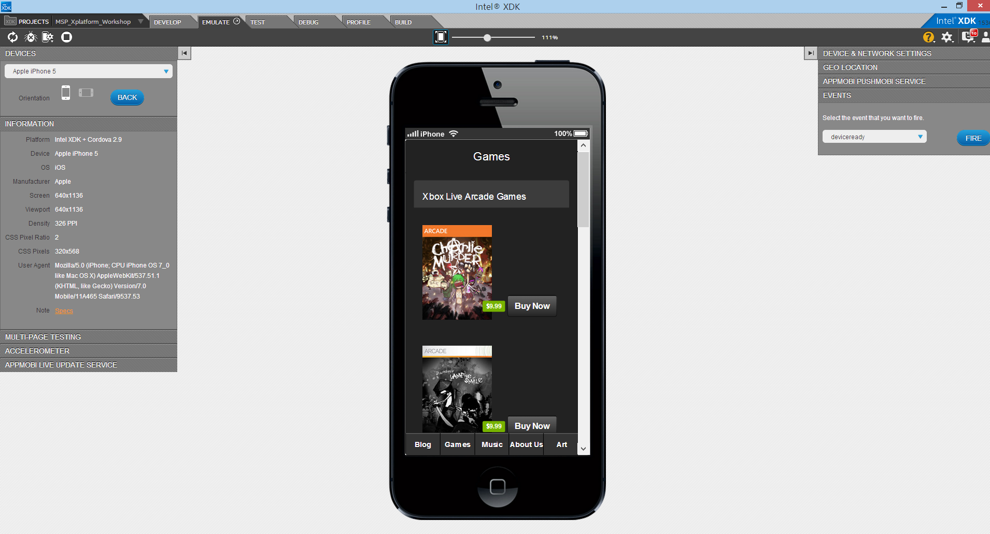
Testing our app
To test our app, click the emulate tap and select the device to emulate on

Slide 14
Deploy to your phone

Slide 15
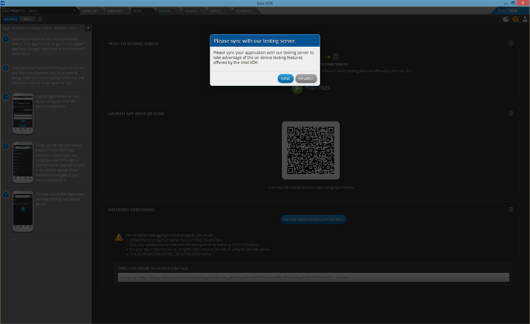
Deploy to your phone
Click the Test tab
You will be asked to sync with the server
Click sync

Slide 16

Deploy to your phone
Download the “Intel App Preview” on your mobile device

Slide 17
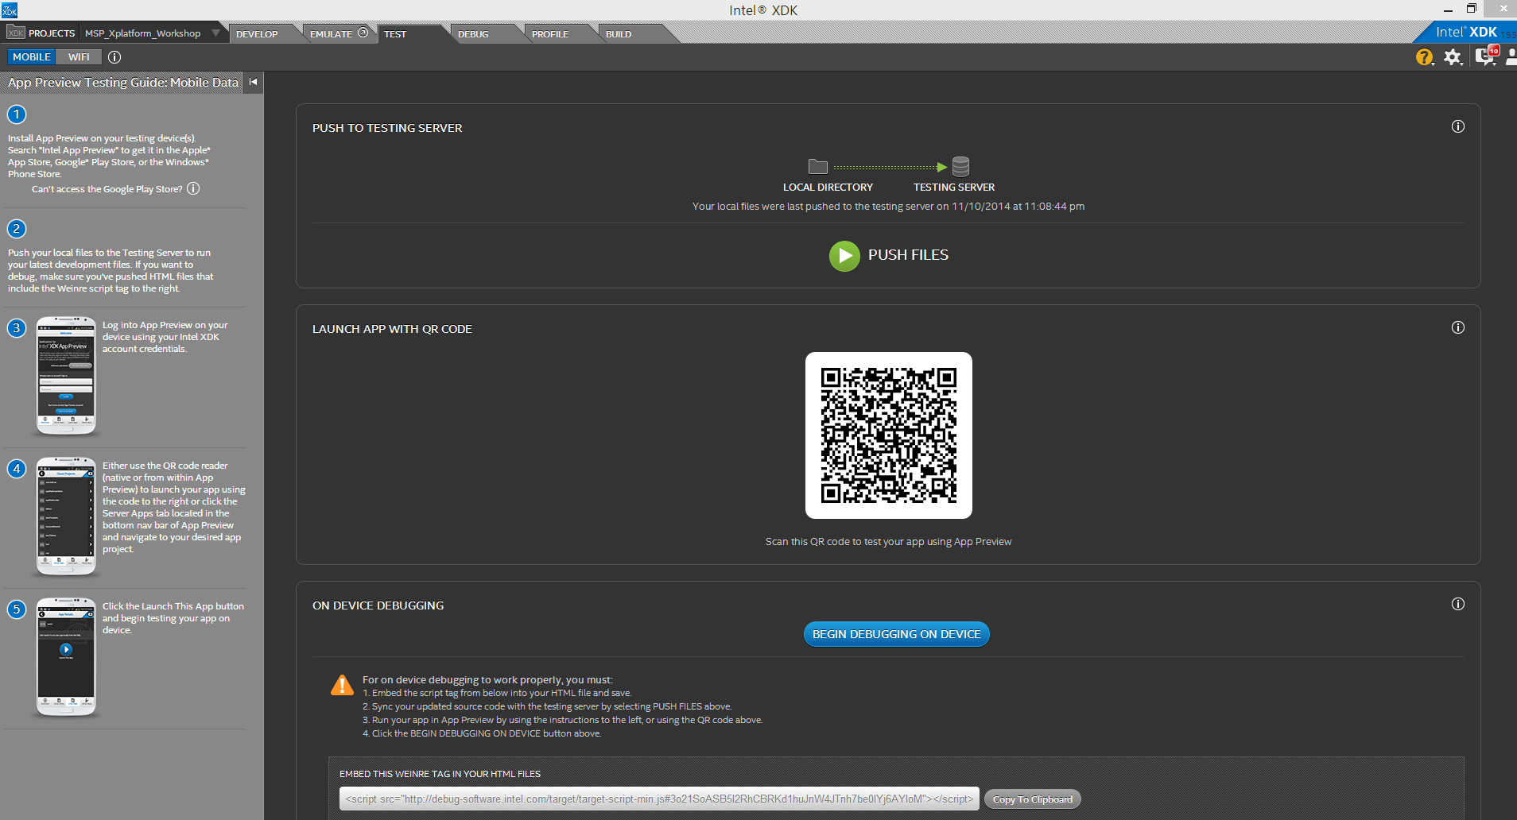
Deploy to your phone
Scan the QR code in the app

Slide 18
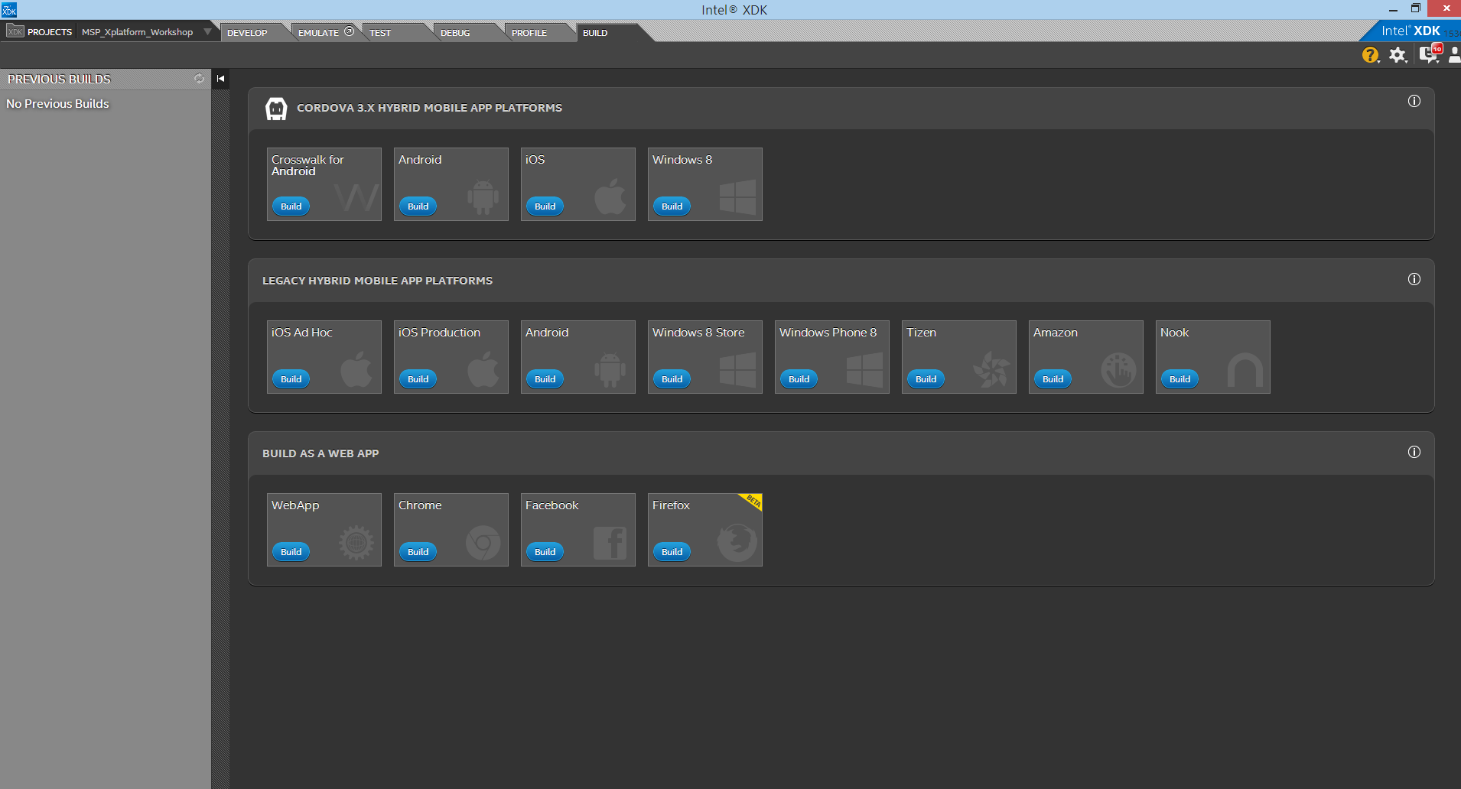
Deploy to your phone
Go to the Build tab
Select the device you want to build for

Slide 19
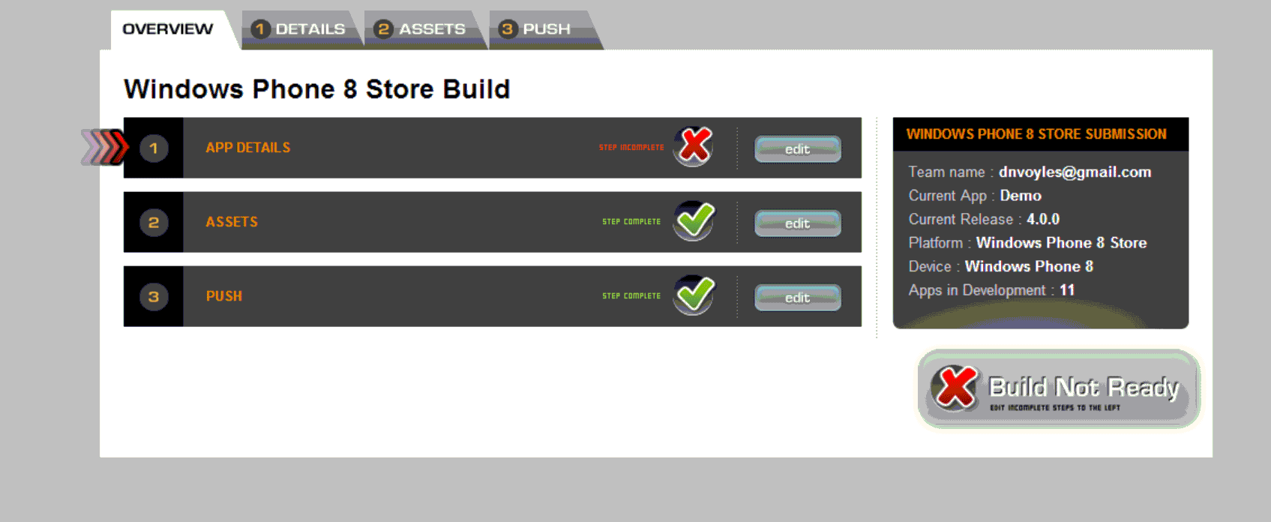
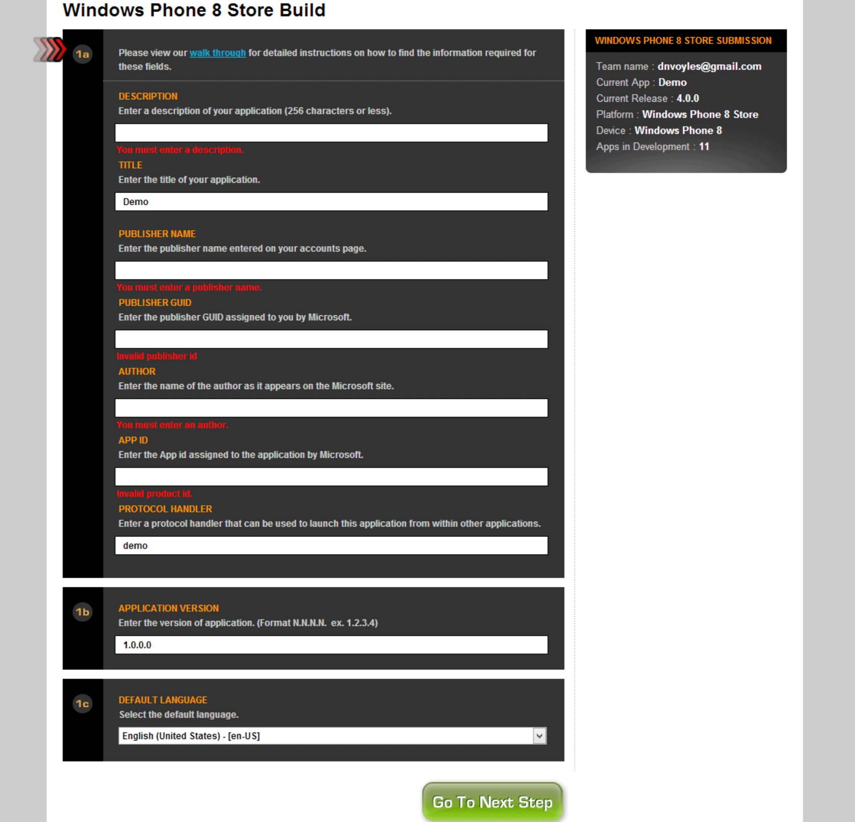
Deploy to your phone
Follow the instructions for your platform

Slide 20
Interested in Imagine Cup?
https://www.imaginecup.com/Content/Details/17393
59:38

